Slide 1
Displaying StreamList User Events
Pantea Namiranian
The University of Arizona Global Campus
INT499: Capstone for Information Technology (INP2520A)
John Russell
5/26/2025
Notes:
Hello everyone! My name is Pantea Namiranian, and I will present the StreamList React application and its features.

Slide 2

Introduction
Demonstrate the features and functionalities of the StreamList React application.
Highlight the importance of user experience
Effective data management, especially when dealing with user inputs.
Notes:
This presentation showcases the StreamList application. We will explore its functionalities and discuss the importance of user experience and data management in web apps.

Slide 3
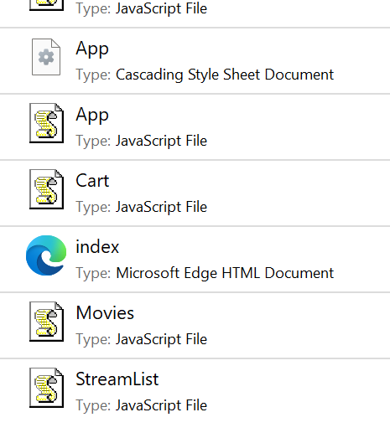
Overview of the Application
Ability to add, edit, delete, and complete tasks.
Simple Unicode characters as icons to enhance user interaction
Manage the movie or program lists effectively.
Notes:
The StreamList application allows users to manage their movie or program lists effectively.
Key features include the ability to add, edit, delete, and complete tasks.
The application uses simple Unicode characters as icons to enhance user interaction without relying on external libraries.

Slide 4
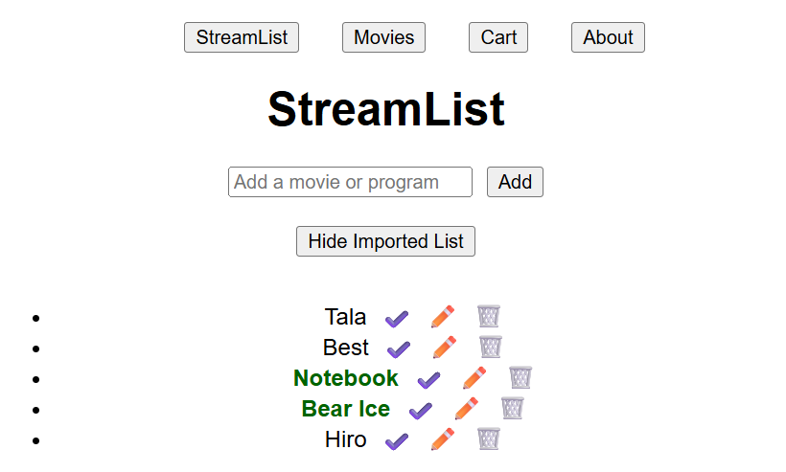
Application Design
Notes:
The design approach focuses on user-friendliness, with a clean layout that makes navigation intuitive.
The navigation system implemented using React Router, allowing seamless transitions between different pages (StreamList, Movies, Cart, About).
The design encourages users to interact with the application easily.

Slide 5
Key Features
User Inputs
Display List
Edit/Delete/Complete
Notes:
Users can add movies or programs to the list. All entries are displayed, and users can edit, delete, or mark tasks as complete with icons.
User Inputs: Users can add movies or programs to the list, which are displayed for visibility.
Display List: All user inputs are shown in a list format, making it easy to see what has been added. Also, there is button to show and hide the list as a feature.
Edit/Delete/Complete: Users can edit the names of items, delete them from the list, or mark them as complete. Completed items are bolded and colored dark green.

Slide 6
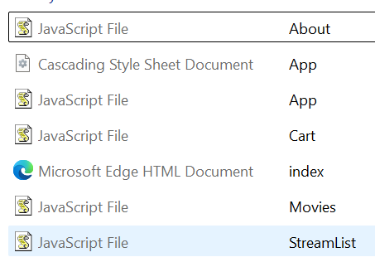
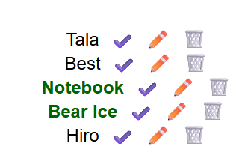

User Interaction
Add
Input Field
Trash Icon
Delete
Add Button
Check Mark Icon
Mark Compeleted
Edit
Pen Icon
Notes:
Users add items through an input field and click "Add." They can delete items or mark them complete. The input field clears automatically after submission. All will be shown live at the end of the presentation by loading the webpage.
Users can add a new item to the list by typing in the input field and clicking the "Add" button.
Delete an item by clicking the trash icon and how to mark an item as complete by clicking the checkmark icon.
The input field clears automatically after submission, allowing for a smooth user experience.

Slide 7

Code overview
State Management: The application uses React's useState hook to manage user inputs and the list of streams.
Functionality: Key functions handle adding, editing, completing, and deleting tasks.
Notes:
By looking at the main code that runs the StreamList application we can say that the useState hook is crucial for managing the state of user inputs and the list of streams. When a user adds a new item, the handleSubmit function updates the state, making sure the new item appears in the list. Each stream item has its own state, which allows users to mark it as complete, edit the title, or delete it. The functions handleComplete, handleEditToggle, and handleDelete are designed to make it easy for users to interact with their list.

Slide 8
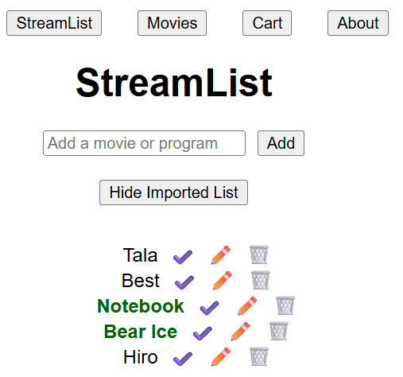
Icons and Visuals
Unicode Icons for Actions:
✔️ for complete
✏️ for edit
🗑️ for delete
Notes:
In this slide, we talk about the icons used in the StreamList application. Instead of using external icon libraries, we chose to use Unicode characters to represent actions. This choice makes the project simpler and avoids the need for extra dependencies. The icons act as visual signals, helping users understand what actions they can take. For example, clicking the checkmark icon marks a task as complete, while the pencil icon allows users to edit the task. This method not only makes the app look better but also improves the user experience by giving immediate feedback on their actions.

Slide 9

Security and Data Protection
Data Privacy: It's important to protect user data in web applications.
Best Practices: Developers should follow good practices for password protection and data security.
Notes:
In this slide, we discuss the importance of security and data protection in web applications. Protecting user data is crucial, especially when handling personal information. Developers have a responsibility to keep this data safe. We should follow best practices for password protection, such as using strong passwords and hashing them to make them secure. This ensures that even if data is compromised, it remains protected. Additionally, we refer to the article on hashing passwords, which explains how this technique helps keep user information safe and why it is essential for developers to implement strong security measures in their applications.

Slide 10

Conclusion
features of the StreamList application
add, edit, delete, and complete tasks
User-Friendly Design
Effective data management
Notes:
In this slide, we summarize the key points we discussed throughout the presentation. We talked about the features of the StreamList application, including how users can add, edit, delete, and complete tasks. We also emphasized the importance of having a user-friendly design that makes it easy for users to interact with the app. Effective data management is crucial for providing a smooth experience. A well-designed application not only helps users manage their lists better but also enhances their overall satisfaction.
Finally, Its time to see the live webpage and its features.

